Slide 1


Flutter
HungNV - @vfaHungnv

Slide 2







What is Flutter ?
Developed by Google
Open-source project
Multi-platform – Android & iOS
Fast development – Hot reload
Native performance
Support multi IDEs

Slide 3
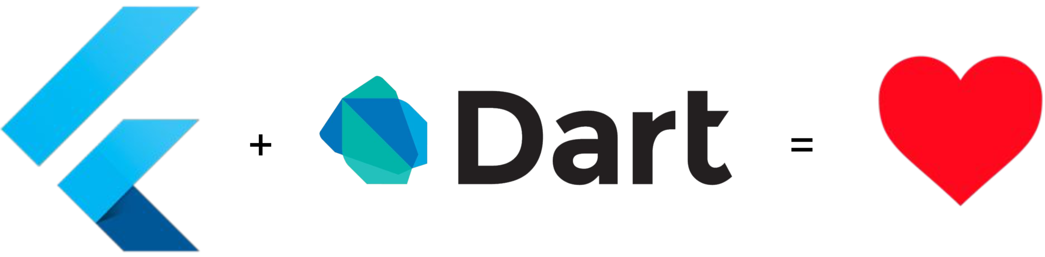
What language is Flutter built with ?

Slide 4

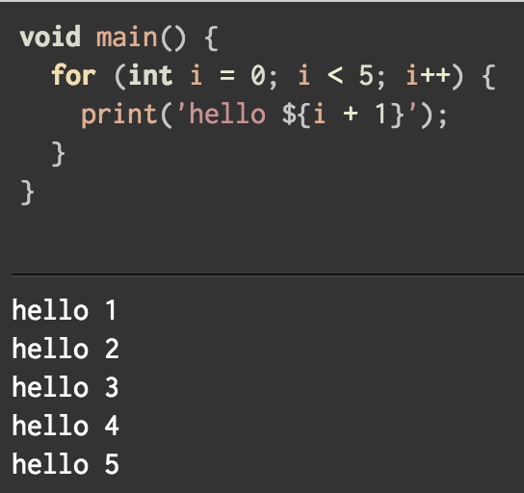
What is Dart ?
Programming language developed by Google.
It is used to build web, server, and mobile applications.
Class based, single-inheritance, object oriented language with C-style syntax.
Supports interfaces, abstract classes, reified generics, strong typing.

Slide 5
How Flutter works ?
Flutter

Slide 6
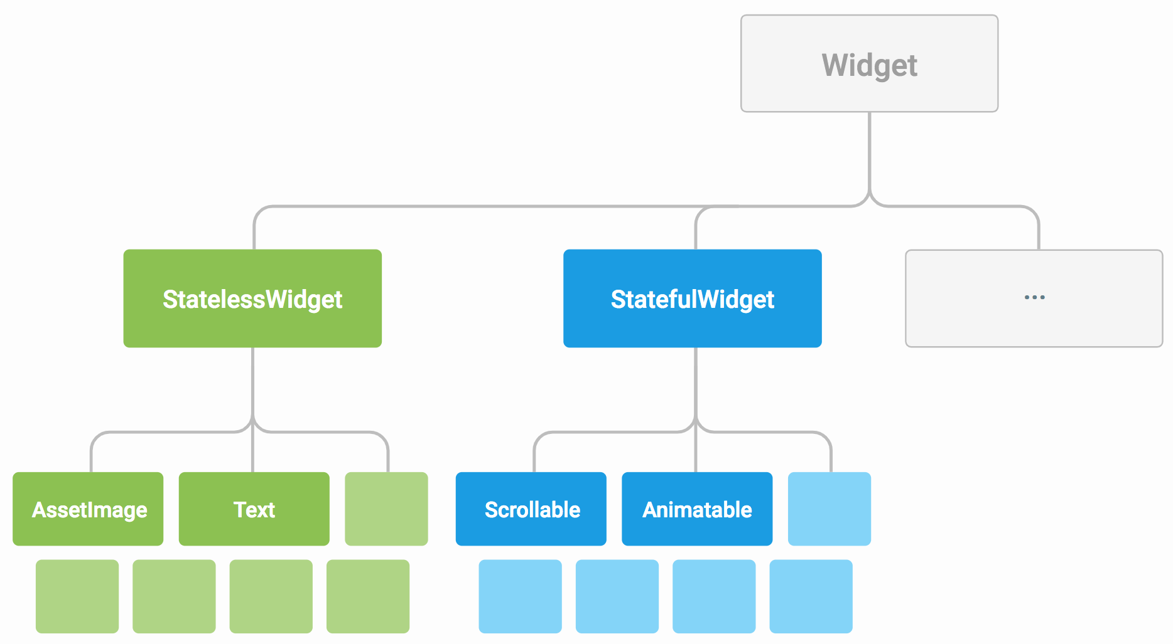
Everything’s a Widget
https://flutter.io/technical-overview/

Slide 7
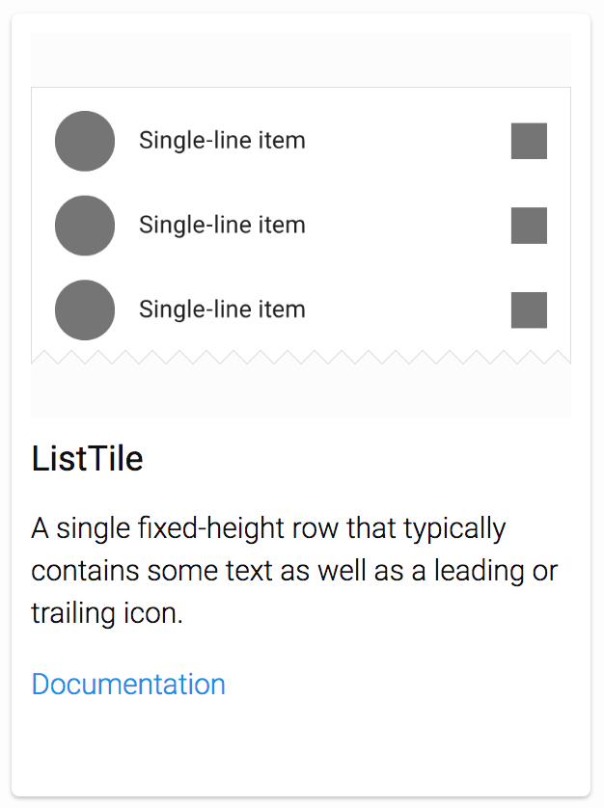
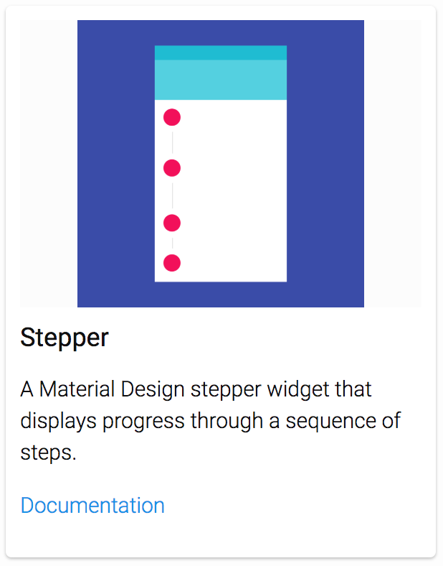
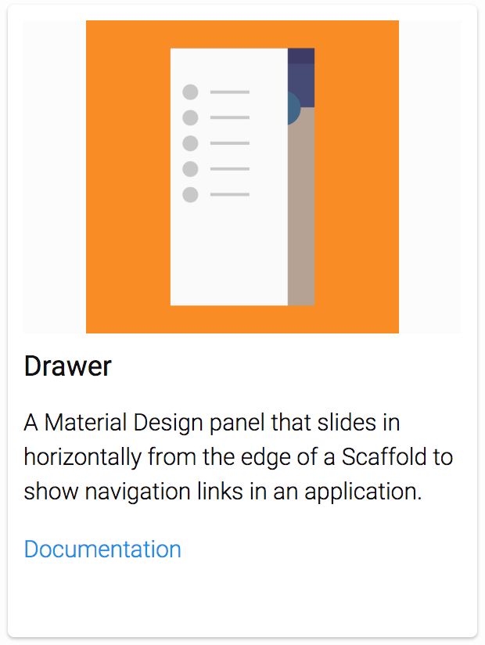
Layout
https://flutter.io/widgets/widgetindex/

Slide 8
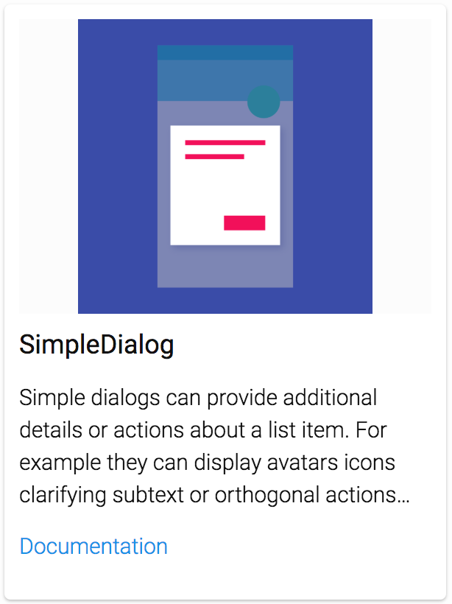
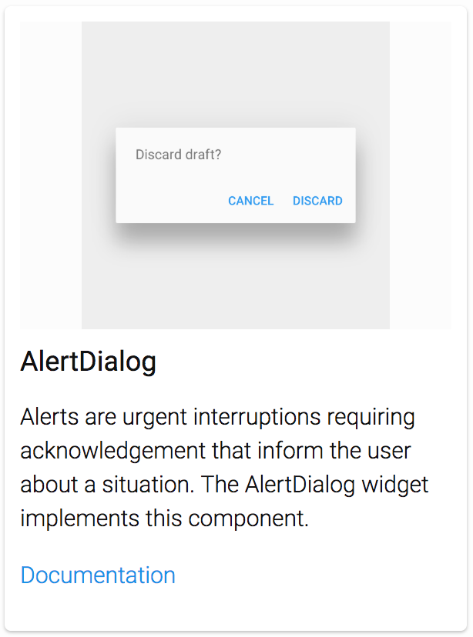
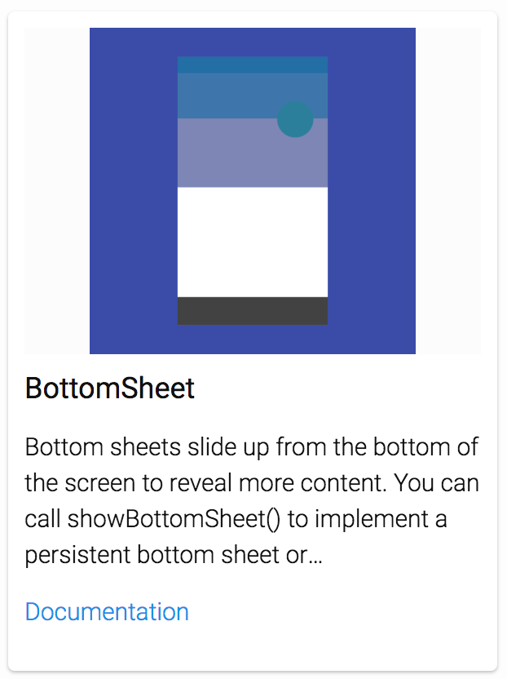
Dialogs, alerts and panels
https://flutter.io/technical-overview/

Slide 9
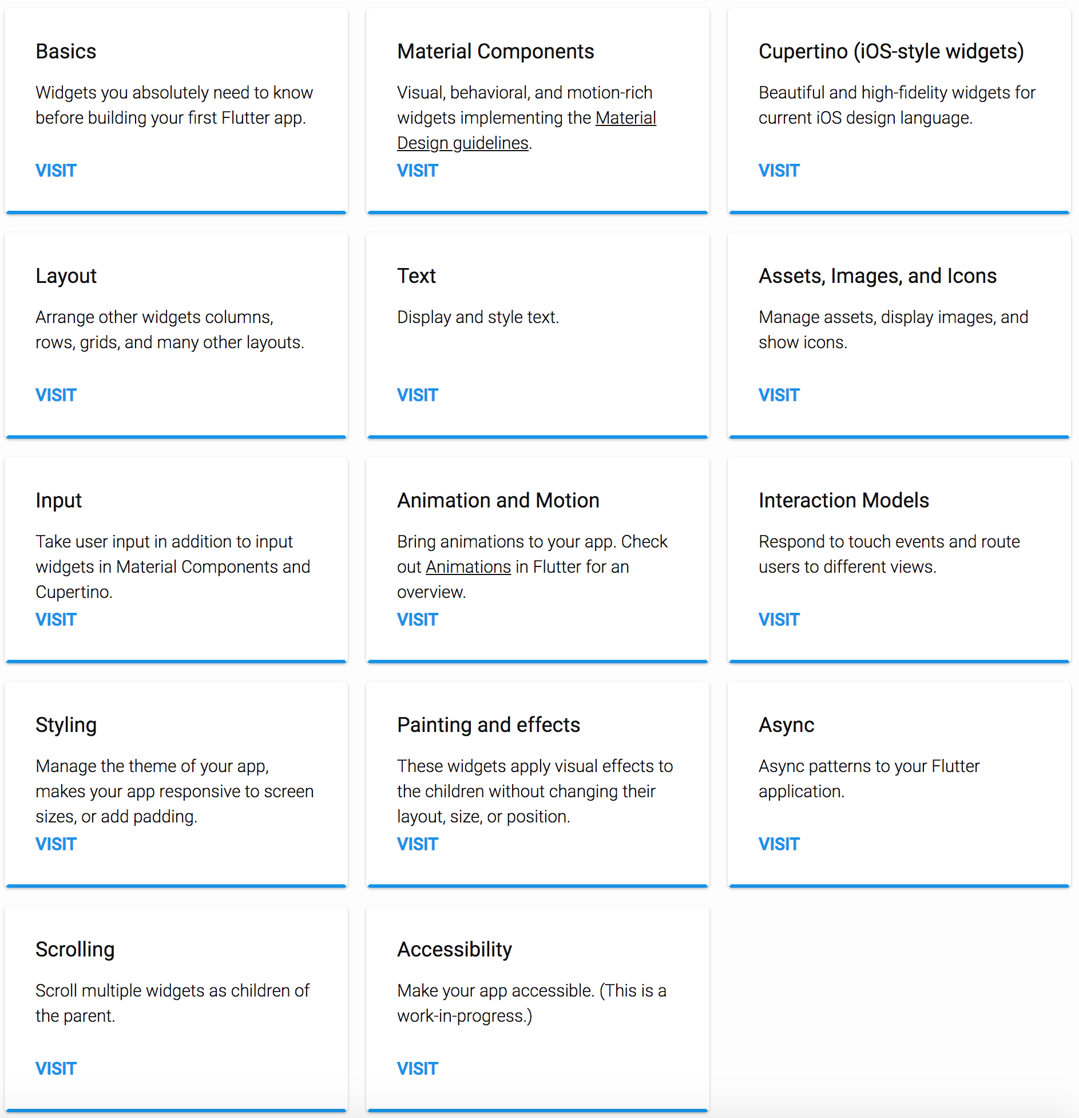
Widgets Catalog
https://flutter.io/widgets/

Slide 10
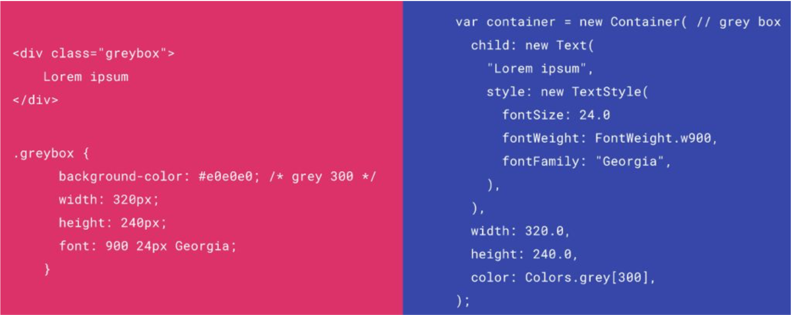
HTML/CSS Analogs in Flutter

Slide 11
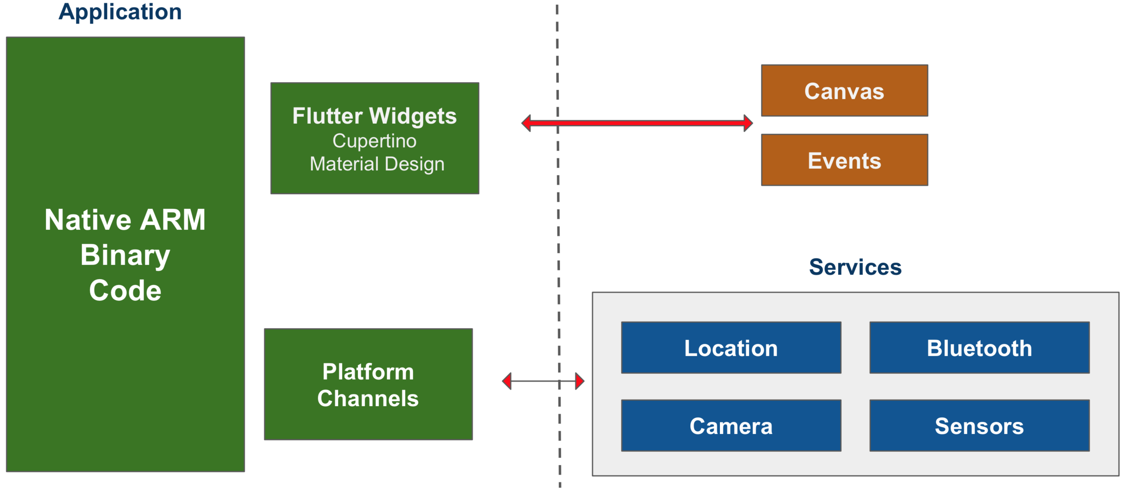
Flutter Approach

Slide 12
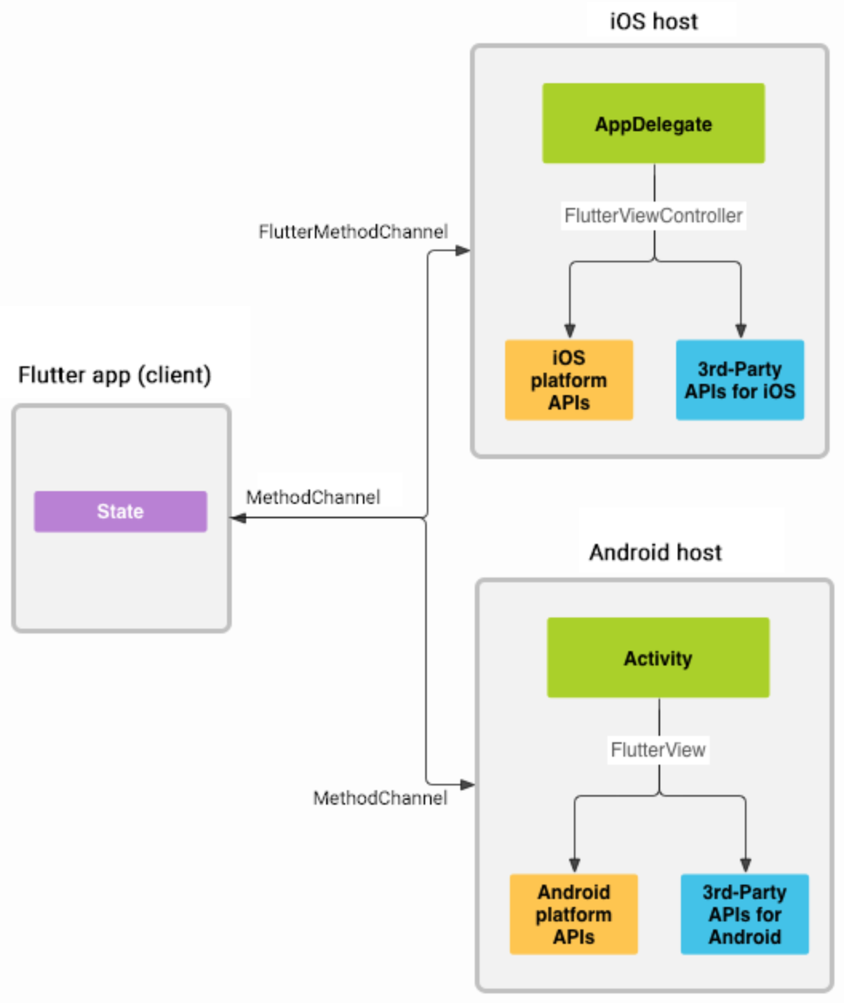
Platform channels

Slide 13
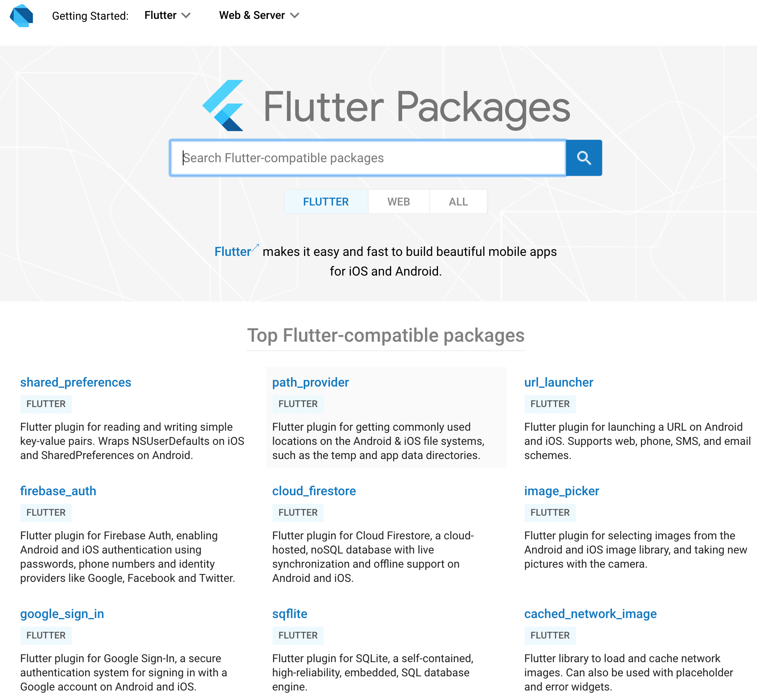
Flutter Packages
https://pub.dartlang.org/flutter

Slide 14
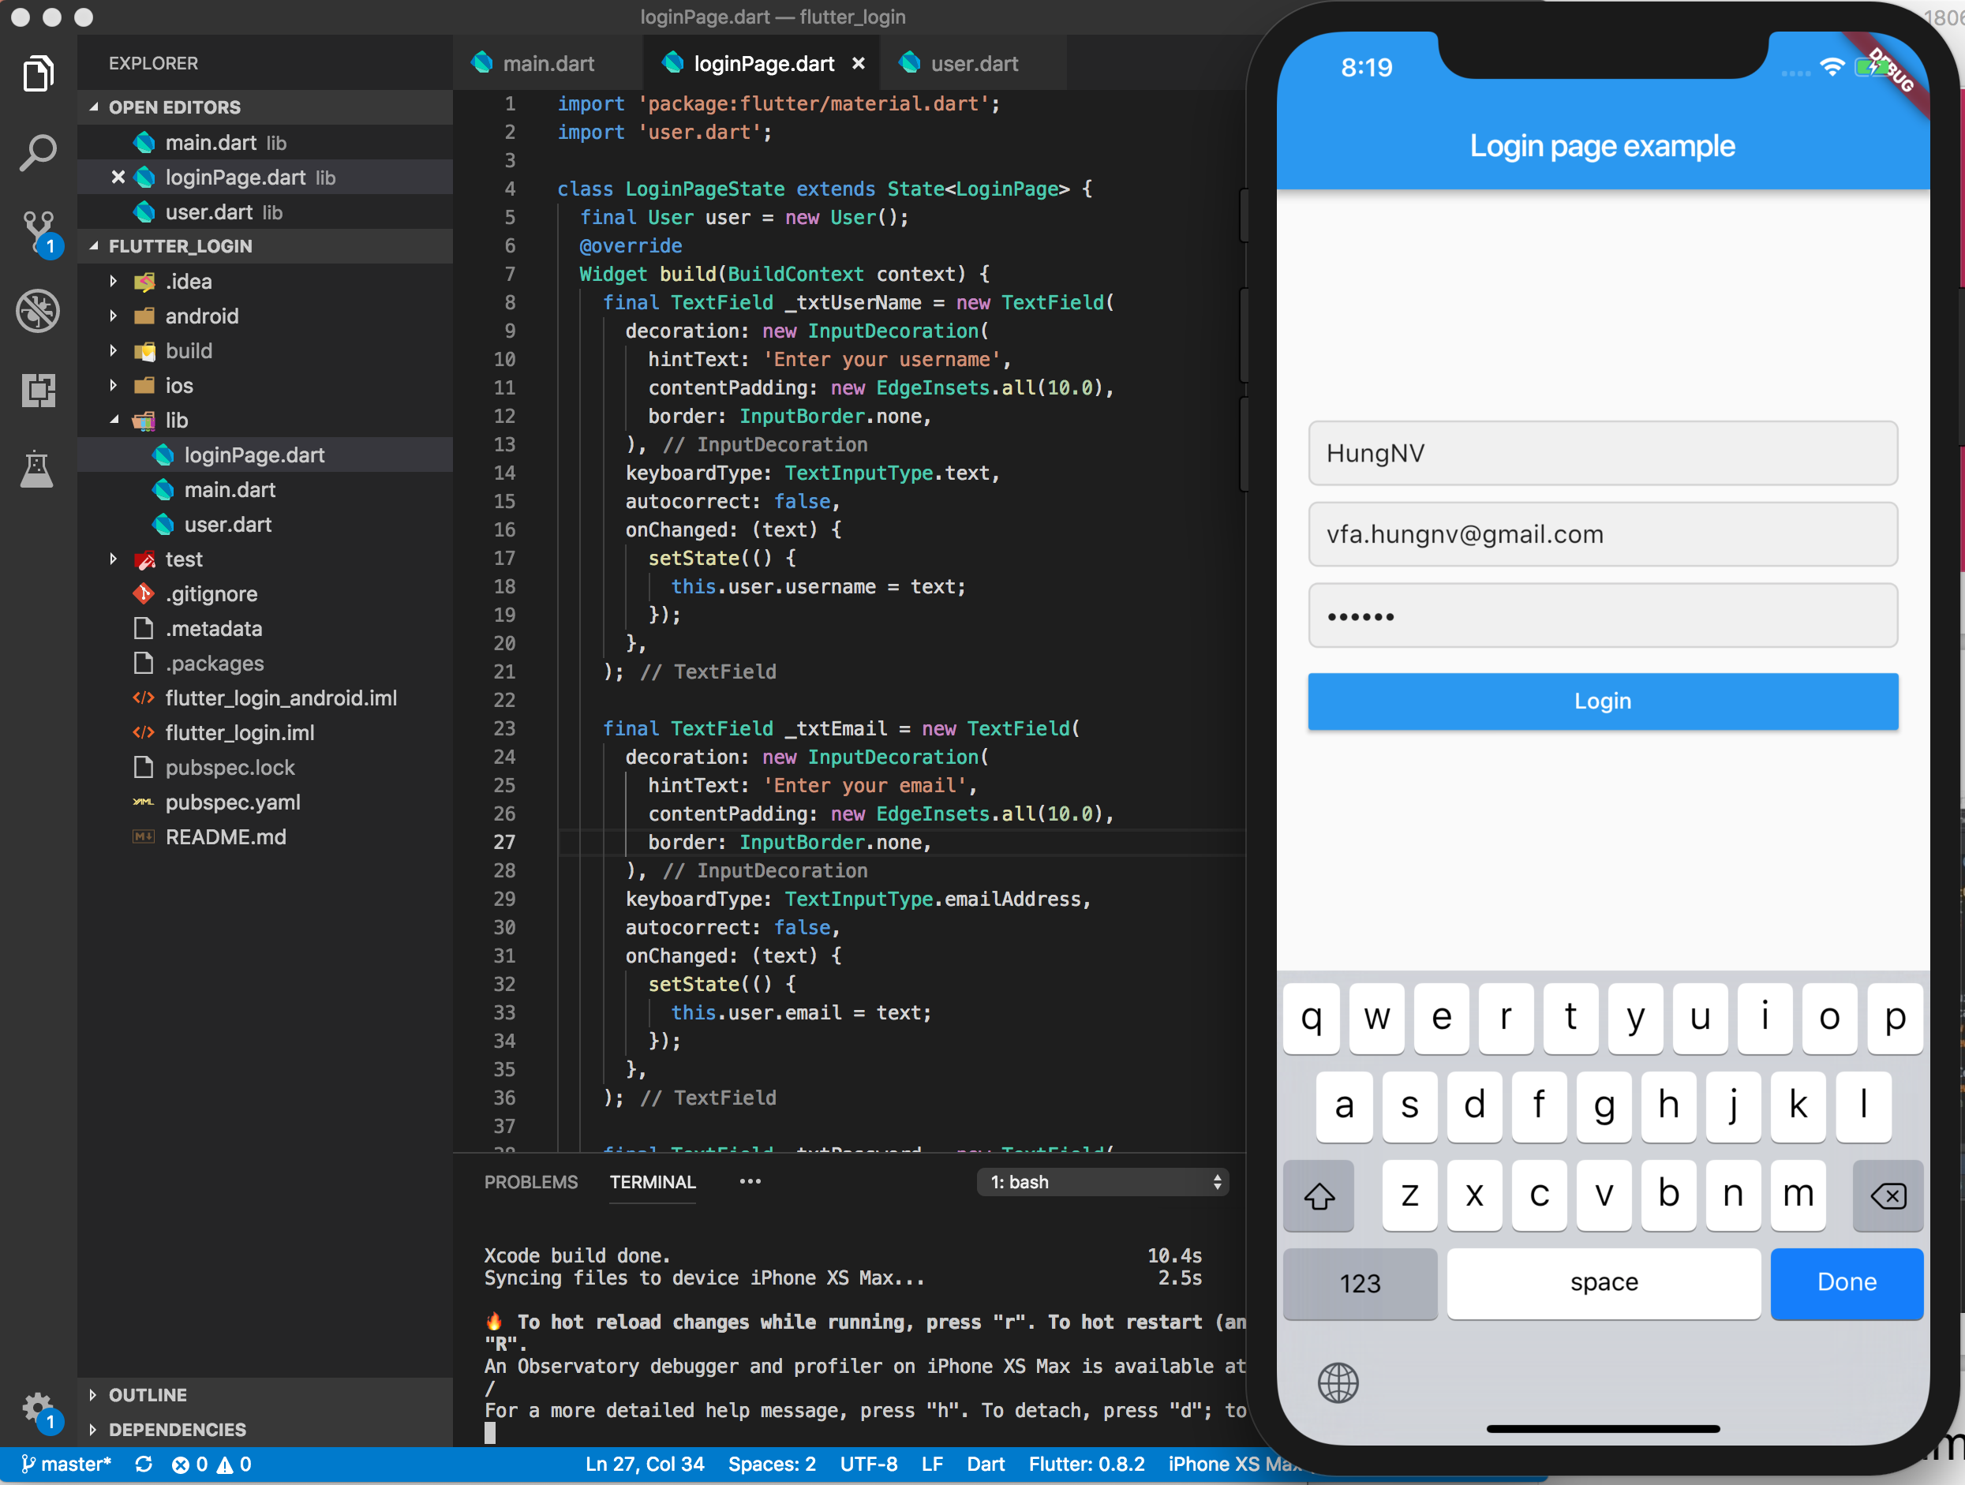
Hot reload

Slide 15
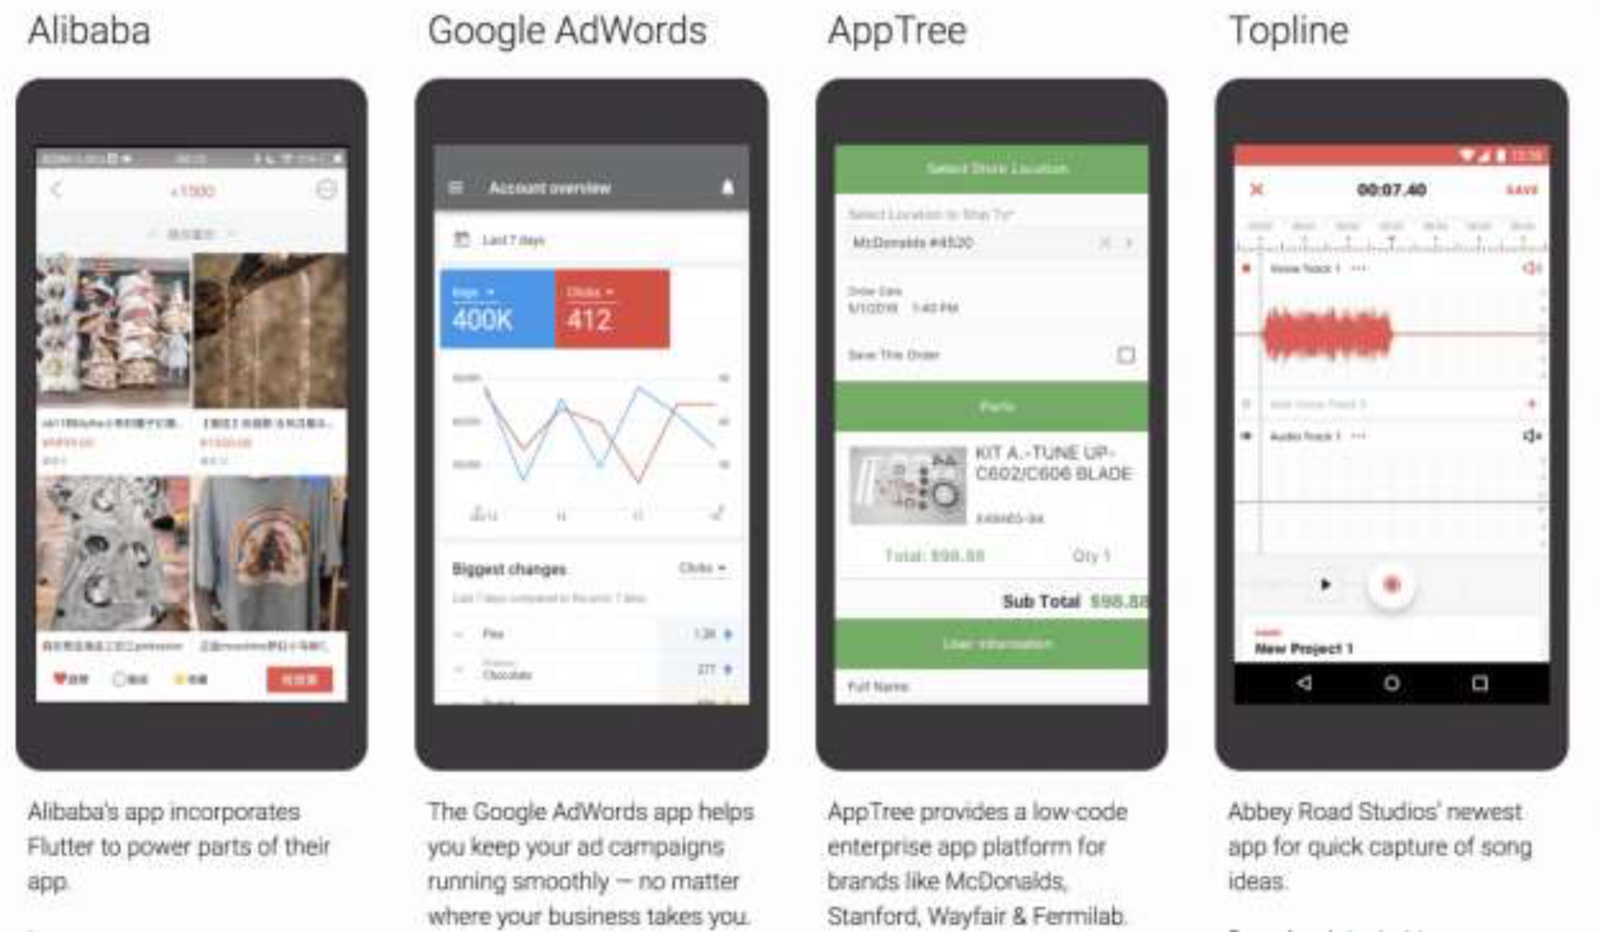
Production Apps

Slide 16
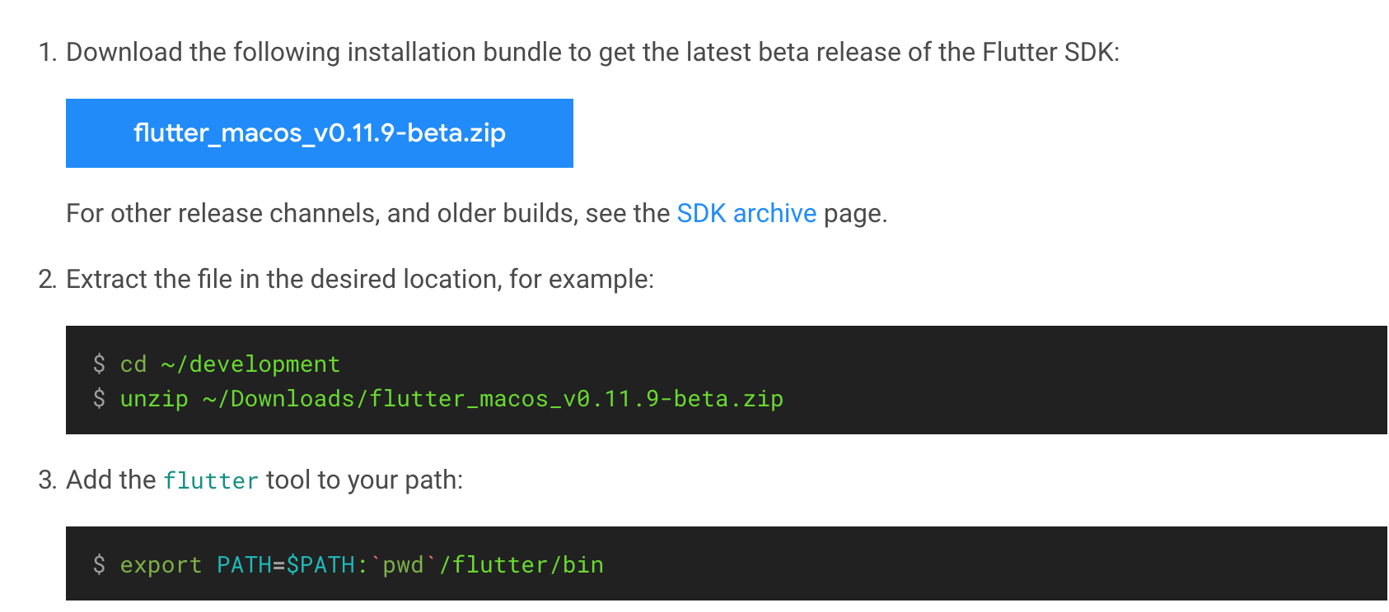
MacOS install

Slide 17
Demo

